Slide 1
Web services
By Adolph

Slide 2
Contents
What is Web Service?
How does a web service work?
What are the advantages of web services?
What are the different types of web services?
What are the main features of web services?
What tools are used to test web services?

Slide 3
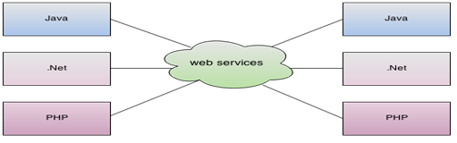
What is web service ?
A Web Service is can be defined by following ways:
is a client server application or application component for communication.
method of communication between two devices over network.
is a software system for interoperable machine to machine communication.
is a collection of standards or protocols for exchanging information between two devices or application.
As you can see in the figure, java, .net or PHP applications can communicate with other applications through web service over the network. For example, java application can interact with Java, .Net and PHP applications.

Slide 4
What is web service ?
Simplified, non-technical explanation: A web serivce allows a PROGRAM to talk to a web page, instead of using your browser to open a web page.
Web service is a means by which computers talk to each other over the web using HTTP and other universally supported protocols.
A Web service is an application that:
Runs on a Web server
Exposes Web methods to interested callers
Listens for HTTP requests representing commands to invoke Web methods
Executes Web methods and returns the results
A web service is a method of communication between two electronic devices over the World Wide Web.
A web service is any piece of software that makes itself available over the internet and uses a standardized XML messaging system. XML is used to encode all communications to a web service.
Web services are XML-based information exchange systems that use the Internet for direct application-to-application interaction.

Slide 5
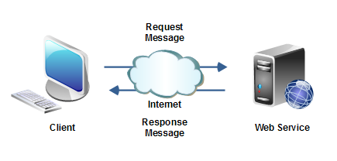
How do web service works?
A web service is used to communicate among various applications by using open standards such as HTML, XML, WSDL, and SOAP.
Client (e.g. mobile app) sends a request to the server with response data, e.g. name of the city to find current weather for (data could be in any format like JSON or XML etc.).
Server processes the request according to the requested data (name of the city). In another word, it fetches the current weather details from the database.
Then sends the data back to the client (mobile app) and client shows the response data in proper format.

Slide 6
What are the advantages of web services?
Interoperability: By the help of web services, an application can communicate with other application developed in any language.
Reusability: We can expose the web service so that other applications can use it.
Modularity: By the help of web service, we can create a service for a specific task such as tax calculation etc.

Slide 7
What are the main features of web services?
Following is a list of main features of web services:
It is available over the Internet or private (intranet) networks.
It uses a standardized XML messaging system.
It is not tied to any one operating system or programming language.
It is self-describing via a common XML grammar.
It is discoverable via a simple find mechanism

Slide 8
What are type of web service ?
There are mainly two types of web services.
SOAP web services.
REST web services.

Slide 9
Soap Web services
SOAP = Simple Object Access Protocol. It is a XML-based protocol for accessing web services.
SOAP is a messaging protocol specification for exchanging structured information in the implementation of web services in computer networks.
SOAP is a method of transferring data over the internet.
SOAP is regarded as heavier than REST i.e. there is more baggage required to transfer data, which means more bandwidth is needed per message request and the data source and targets have more work to do when packaging and receiving the data.
SOAP only uses XML for messaging services over the internet, and XML message requests can be very complex and if developed manually, careful attention is required because SOAP is inflexible with errors.
One of the pieces of baggage that accompanies a SOAP message is the Web Services Description Language (“WSDL”) to explain how the web service works.
What is WSDL?
WSDL is an XML-based language for describing Web services and how to access them.
WSDL stands for Web Services Description Language
WSDL is based on XML
WSDL is used to describe Web services
WSDL is also used to locate Web services
WSDL is a W3C standard

Slide 10
SOAP Building Blocks
A SOAP message is an ordinary XML document containing the following elements:
An Envelope element that identifies the XML document as a SOAP message
A Header element that contains header information
A Body element that contains call and response information
A Fault element containing errors and status information
All the elements above are declared in the default namespace for the SOAP envelope
Syntax Rules
Here are some important syntax rules:
A SOAP message MUST be encoded using XML
A SOAP message MUST use the SOAP Envelope namespace
A SOAP message MUST use the SOAP Encoding namespace
A SOAP message must NOT contain a DTD reference
A SOAP message must NOT contain XML Processing Instructions
The xmlns:soap Namespace
Notice the xmlns:soap namespace in the example above. It should always have the value of: "http://www.w3.org/2003/05/soap-envelope/".
The namespace defines the Envelope as a SOAP Envelope.
If a different namespace is used, the application generates an error and discards the message.

Slide 11
Skeleton SOAP Message
<?xml version="1.0"?> <soap:Envelope xmlns:soap="http://www.w3.org/2003/05/soap-envelope/" soap:encodingStyle="http://www.w3.org/2003/05/soap-encoding"> <soap:Header> ... </soap:Header> <soap:Body> ... <soap:Fault> ... </soap:Fault> </soap:Body> </soap:Envelope>
The SOAP Fault Element
The optional SOAP Fault element is used to indicate error messages.
The SOAP Fault element holds errors and status information for a SOAP message.
If a Fault element is present, it must appear as a child element of the Body element. A Fault element can only appear once in a SOAP message.
The SOAP Fault element has the following sub elements:
Sub Element | Description
<faultcode> | A code for identifying the fault
<faultstring> | A human readable explanation of the fault
<faultactor> | Information about who caused the fault to happen
<detail> | Holds application specific error information related to the Body element

Slide 12
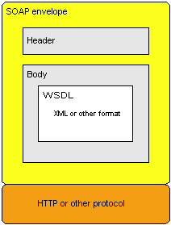
Soap Web service Structure
SOAP provides the envelope for sending Web Services messages over the Internet/Internet
The SOAP envelope contains two parts:
1. An optional header providing information on authentication, encoding of data, or how a recipient of a SOAP message should process the message.
2. The body that contains the message. These messages can be defined using the WSDL specification

Slide 13
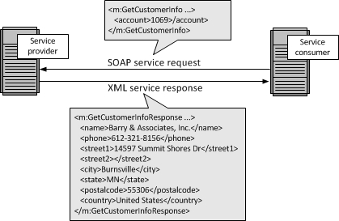
Soap Web services
Below illustrate soap service

Slide 14
Soap Web services
Advantages of SOAP | Disadvantages of SOAP
WS Security: SOAP defines its own security known as WS Security. | Slow: SOAP uses XML format that must be parsed to be read. It defines many standards that must be followed while developing the SOAP applications. So it is slow and consumes more bandwidth and resource.
Language and Platform independent: SOAP web services can be written in any programming language and executed in any platform. | WSDL dependent: SOAP uses WSDL and doesn't have any other mechanism to discover the service.

Slide 15
Representational State Transfer (REST)Web services
REST = REpresentational State Transfer.
RESTful Web Services are basically REST Architecture based Web Services. In REST Architecture everything is a resource. RESTful web services are light weight, highly scalable and maintainable and are very commonly used to create APIs for web-based applications.
REST is a web standards based architecture and uses HTTP Protocol for data communication. It revolves around resources where every component is a resource and a resource is accessed by a common interface using HTTP standard methods.
In REST architecture, a REST Server simply provides access to resources and the REST client accesses and presents the resources. Here each resource is identified by URIs/ Global IDs.
REST is an architectural style not a protocol
Unlike SOAP, REST does not use XML exclusively; plain text, CSV, and RSS can be used, as well as JSON for AJAX calls; as long as both the source and targets can understand the formats used.
REST uses various representations to represent a resource like Text, JSON and XML. JSON is now the most popular format being used in Web Services.

Slide 16
Representational State Transfer (REST)Web services
HTTP Methods
The following HTTP methods are most commonly used in a REST based architecture.
GET − Provides a read only access to a resource.
PUT − Used to create a new resource.
DELETE − Used to remove a resource.
POST − Used to update an existing resource or create a new resource.
OPTIONS − Used to get the supported operations on a resource.
Web services based on REST Architecture are known as RESTful Web Services. These web services use HTTP methods to implement the concept of REST architecture.

Slide 17
Representational State Transfer (REST)Web services
The following principles encourage RESTful applications to be simple, lightweight, and fast:
Resource identification through URI: A RESTful web service exposes a set of resources that identify the targets of the interaction with its clients. Resources are identified by URIs, which provide a global addressing space for resource and service discovery. See The @Path Annotation and URI Path Templates for more information.
Uniform interface: Resources are manipulated using a fixed set of four create, read, update, delete operations: PUT, GET, POST, and DELETE. PUT creates a new resource, which can be then deleted by using DELETE. GET retrieves the current state of a resource in some representation. POST transfers a new state onto a resource. See Responding to HTTP Methods and Requests for more information.
Self-descriptive messages: Resources are decoupled from their representation so that their content can be accessed in a variety of formats, such as HTML, XML, plain text, PDF, JPEG, JSON, and others. Metadata about the resource is available and used, for example, to control caching, detect transmission errors, negotiate the appropriate representation format, and perform authentication or access control. See Responding to HTTP Methods and Requests and Using Entity Providers to Map HTTP Response and Request Entity Bodies for more information.
Stateful interactions through hyperlinks: Every interaction with a resource is stateless; that is, request messages are self-contained. Stateful interactions are based on the concept of explicit state transfer. Several techniques exist to exchange state, such as URI rewriting, cookies, and hidden form fields. State can be embedded in response messages to point to valid future states of the interaction. See Using Entity Providers to Map HTTP Response and Request Entity Bodies and “Building URIs” in the JAX-RS Overview document for more information.

Slide 18
Representational State Transfer (REST)Web services
Advantages of REST | Disadvantages of REST
Fast: RESTful Web Services are fast because there is no strict specification like SOAP. It consumes less bandwidth and resource.
Language and Platform independent: SOAP web services can be written in any programming language and executed in any platform.
Can use SOAP: RESTful web services can use SOAP web services as the implementation.
Permits different data format: RESTful web service permits different data format such as Plain Text, HTML, XML and JSON.

Slide 19
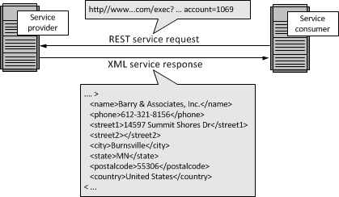
REST Web services
Below illustrate REST service

Slide 20
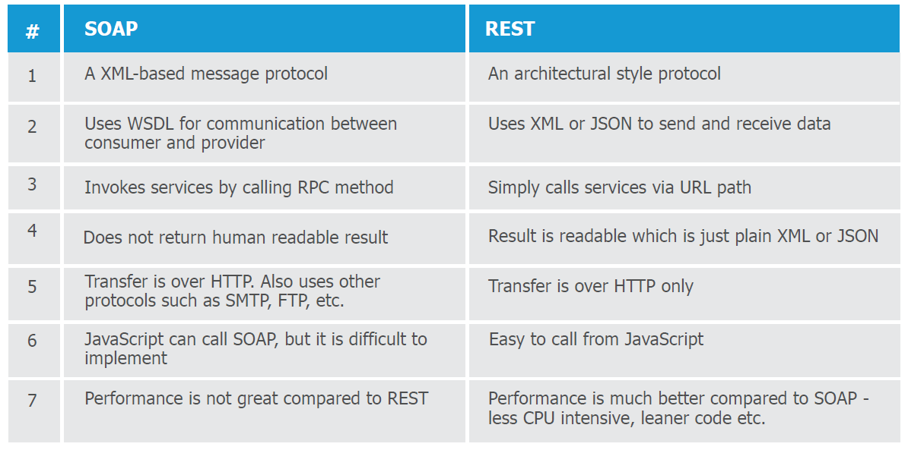
Difference between SOAP and REST

Slide 21
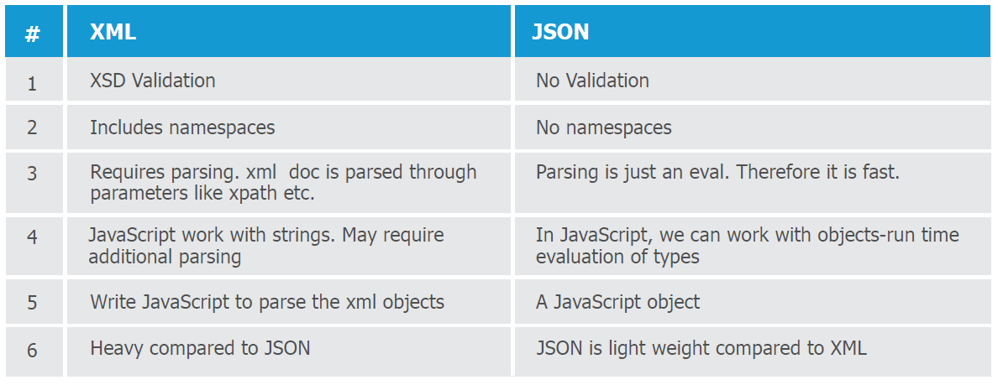
Brief comparison between XML and JSON:

Slide 22
JAVA web services
Java web service application perform communication through WSDL (Web Services Description Language). There are two ways to write java web service application code: SOAP and RESTful.
Java Web Services API
There are two main API's defined by Java for developing web service applications since JavaEE 6.
1) JAX-WS: for SOAP web services.
The are two ways to write JAX-WS application code:
RPC style
and Document style.
2) JAX-RS: for RESTful web services.
There are mainly 2 implementation currently in use for creating JAX-RS application:
Jersey
and RESTeasy.

Slide 23
JAVA web services
Java web services API
SOAP
REST
JAX-WS
JAX-RS
RPC Style
Document Style
Jersey
RESTeasy

Slide 24
JAX-WS [SOAP]
RPC Web service | Document web service
The generated WSDL is difficult to be validated against schema. | Document style web services can be validated against predefined schema.
In RPC style, SOAP message is sent as many elements. | In document style, SOAP message is sent as a single document.
RPC style message is tightly coupled. | Document style message is loosely coupled.
In RPC style, SOAP message keeps the operation name. | In Document style, SOAP message loses the operation name.
In RPC style, parameters are sent as discrete values. | In Document style, parameters are sent in XML format.
Example : 1. In WSDL file, it doesn't specify the types details. <types/> 2. For message part, it defines name and type attributes. <message name="getHelloWorldAsString"> <part name="arg0" type="xsd:string"/> </message> <message name="getHelloWorldAsStringResponse"> <part name="return" type="xsd:string"/> </message> | Example : 1. In WSDL file, it specifies types details having namespace and schemaLocation. <types> <xsd:schema> <xsd:import namespace="http://javatpoint.com/" schemaLocation="http://localhost:7779/ws/hello?xsd=1"/> </xsd:schema> </types> 2. For message part, it defines name and element attributes. <message name="getHelloWorldAsString"> <part name="parameters" element="tns:getHelloWorldAsString"/> </message> <message name="getHelloWorldAsStringResponse"> <part name="parameters" element="tns:getHelloWorldAsStringResponse"/> </message>

Slide 25
Actual examples
RPC WSDL | DOC WSDL
<definitions xmlns:wsu="http://docs.oasis-open.org/wss/2004/01/oasis-200401-wss-wssecurity-utility-1.0.xsd" xmlns:wsp="http://www.w3.org/ns/ws-policy" xmlns:wsp1_2="http://schemas.xmlsoap.org/ws/2004/09/policy" xmlns:wsam="http://www.w3.org/2007/05/addressing/metadata" xmlns:soap="http://schemas.xmlsoap.org/wsdl/soap/" xmlns:tns="http://server.jaxwsRPC.typeAR.co.za/" xmlns:xsd="http://www.w3.org/2001/XMLSchema" xmlns="http://schemas.xmlsoap.org/wsdl/" targetNamespace="http://server.jaxwsRPC.typeAR.co.za/" name="JaxwsRPCImplService"> <types/> <message name="getHelloWorldAsString"> <part name="arg0" type="xsd:string"/> </message> <message name="getHelloWorldAsStringResponse"> <part name="return" type="xsd:string"/> </message> <portType name="JaxwsRPCInterface"> <operation name="getHelloWorldAsString"> <input wsam:Action="http://server.jaxwsRPC.typeAR.co.za/JaxwsRPCInterface/getHelloWorldAsStringRequest" message="tns:getHelloWorldAsString"/> <output wsam:Action="http://server.jaxwsRPC.typeAR.co.za/JaxwsRPCInterface/getHelloWorldAsStringResponse" message="tns:getHelloWorldAsStringResponse"/> </operation> </portType> <binding name="JaxwsRPCImplPortBinding" type="tns:JaxwsRPCInterface"> <soap:binding transport="http://schemas.xmlsoap.org/soap/http" style="rpc"/> <operation name="getHelloWorldAsString"> <soap:operation soapAction=""/> <input> <soap:body use="literal" namespace="http://server.jaxwsRPC.typeAR.co.za/"/> </input> <output> <soap:body use="literal" namespace="http://server.jaxwsRPC.typeAR.co.za/"/> </output> </operation> </binding> <service name="JaxwsRPCImplService"> <port name="JaxwsRPCImplPort" binding="tns:JaxwsRPCImplPortBinding"> <soap:address location="http://localhost:9991/jaxwsRPCExample"/> </port> </service> </definitions> | <definitions xmlns:wsu="http://docs.oasis-open.org/wss/2004/01/oasis-200401-wss-wssecurity-utility-1.0.xsd" xmlns:wsp="http://www.w3.org/ns/ws-policy" xmlns:wsp1_2="http://schemas.xmlsoap.org/ws/2004/09/policy" xmlns:wsam="http://www.w3.org/2007/05/addressing/metadata" xmlns:soap="http://schemas.xmlsoap.org/wsdl/soap/" xmlns:tns="http://server.jaxwsDOC.typeAR.co.za/" xmlns:xsd="http://www.w3.org/2001/XMLSchema" xmlns="http://schemas.xmlsoap.org/wsdl/" targetNamespace="http://server.jaxwsDOC.typeAR.co.za/" name="JaxwsDOCImpService"> <types> <xsd:schema> <xsd:import namespace="http://server.jaxwsDOC.typeAR.co.za/" schemaLocation="http://localhost:9991/jaxwsDOCExample?xsd=1"/> </xsd:schema> </types> <message name="getHelloWorldAsString"> <part name="parameters" element="tns:getHelloWorldAsString"/> </message> <message name="getHelloWorldAsStringResponse"> <part name="parameters" element="tns:getHelloWorldAsStringResponse"/> </message> <portType name="JaxwsDOCInterface"> <operation name="getHelloWorldAsString"> <input wsam:Action="http://server.jaxwsDOC.typeAR.co.za/JaxwsDOCInterface/getHelloWorldAsStringRequest" message="tns:getHelloWorldAsString"/> <output wsam:Action="http://server.jaxwsDOC.typeAR.co.za/JaxwsDOCInterface/getHelloWorldAsStringResponse" message="tns:getHelloWorldAsStringResponse"/> </operation> </portType> <binding name="JaxwsDOCImpPortBinding" type="tns:JaxwsDOCInterface"> <soap:binding transport="http://schemas.xmlsoap.org/soap/http" style="document"/> <operation name="getHelloWorldAsString"> <soap:operation soapAction=""/> <input> <soap:body use="literal"/> </input> <output> <soap:body use="literal"/> </output> </operation> </binding> <service name="JaxwsDOCImpService"> <port name="JaxwsDOCImpPort" binding="tns:JaxwsDOCImpPortBinding"> <soap:address location="http://localhost:9991/jaxwsDOCExample"/> </port> </service> </definitions>

Slide 26
JAX-WS [SOAP] Examples
git
ADOLPH REPOSITORY SPACE\WEB Services\SOAP\JAX-WS\RPC-Webservices\Example

Slide 27
JAX-RS [REST]
Jersey
RESTEasy

Slide 28
What tools are used to test web services?
SoapUI tool for testing SOAP and RESTful web services
Poster for firefox browser
Postman extension for Chrome
Swagger

